Slide 1
Xiang yang Shi
Oct 16th

Slide 2
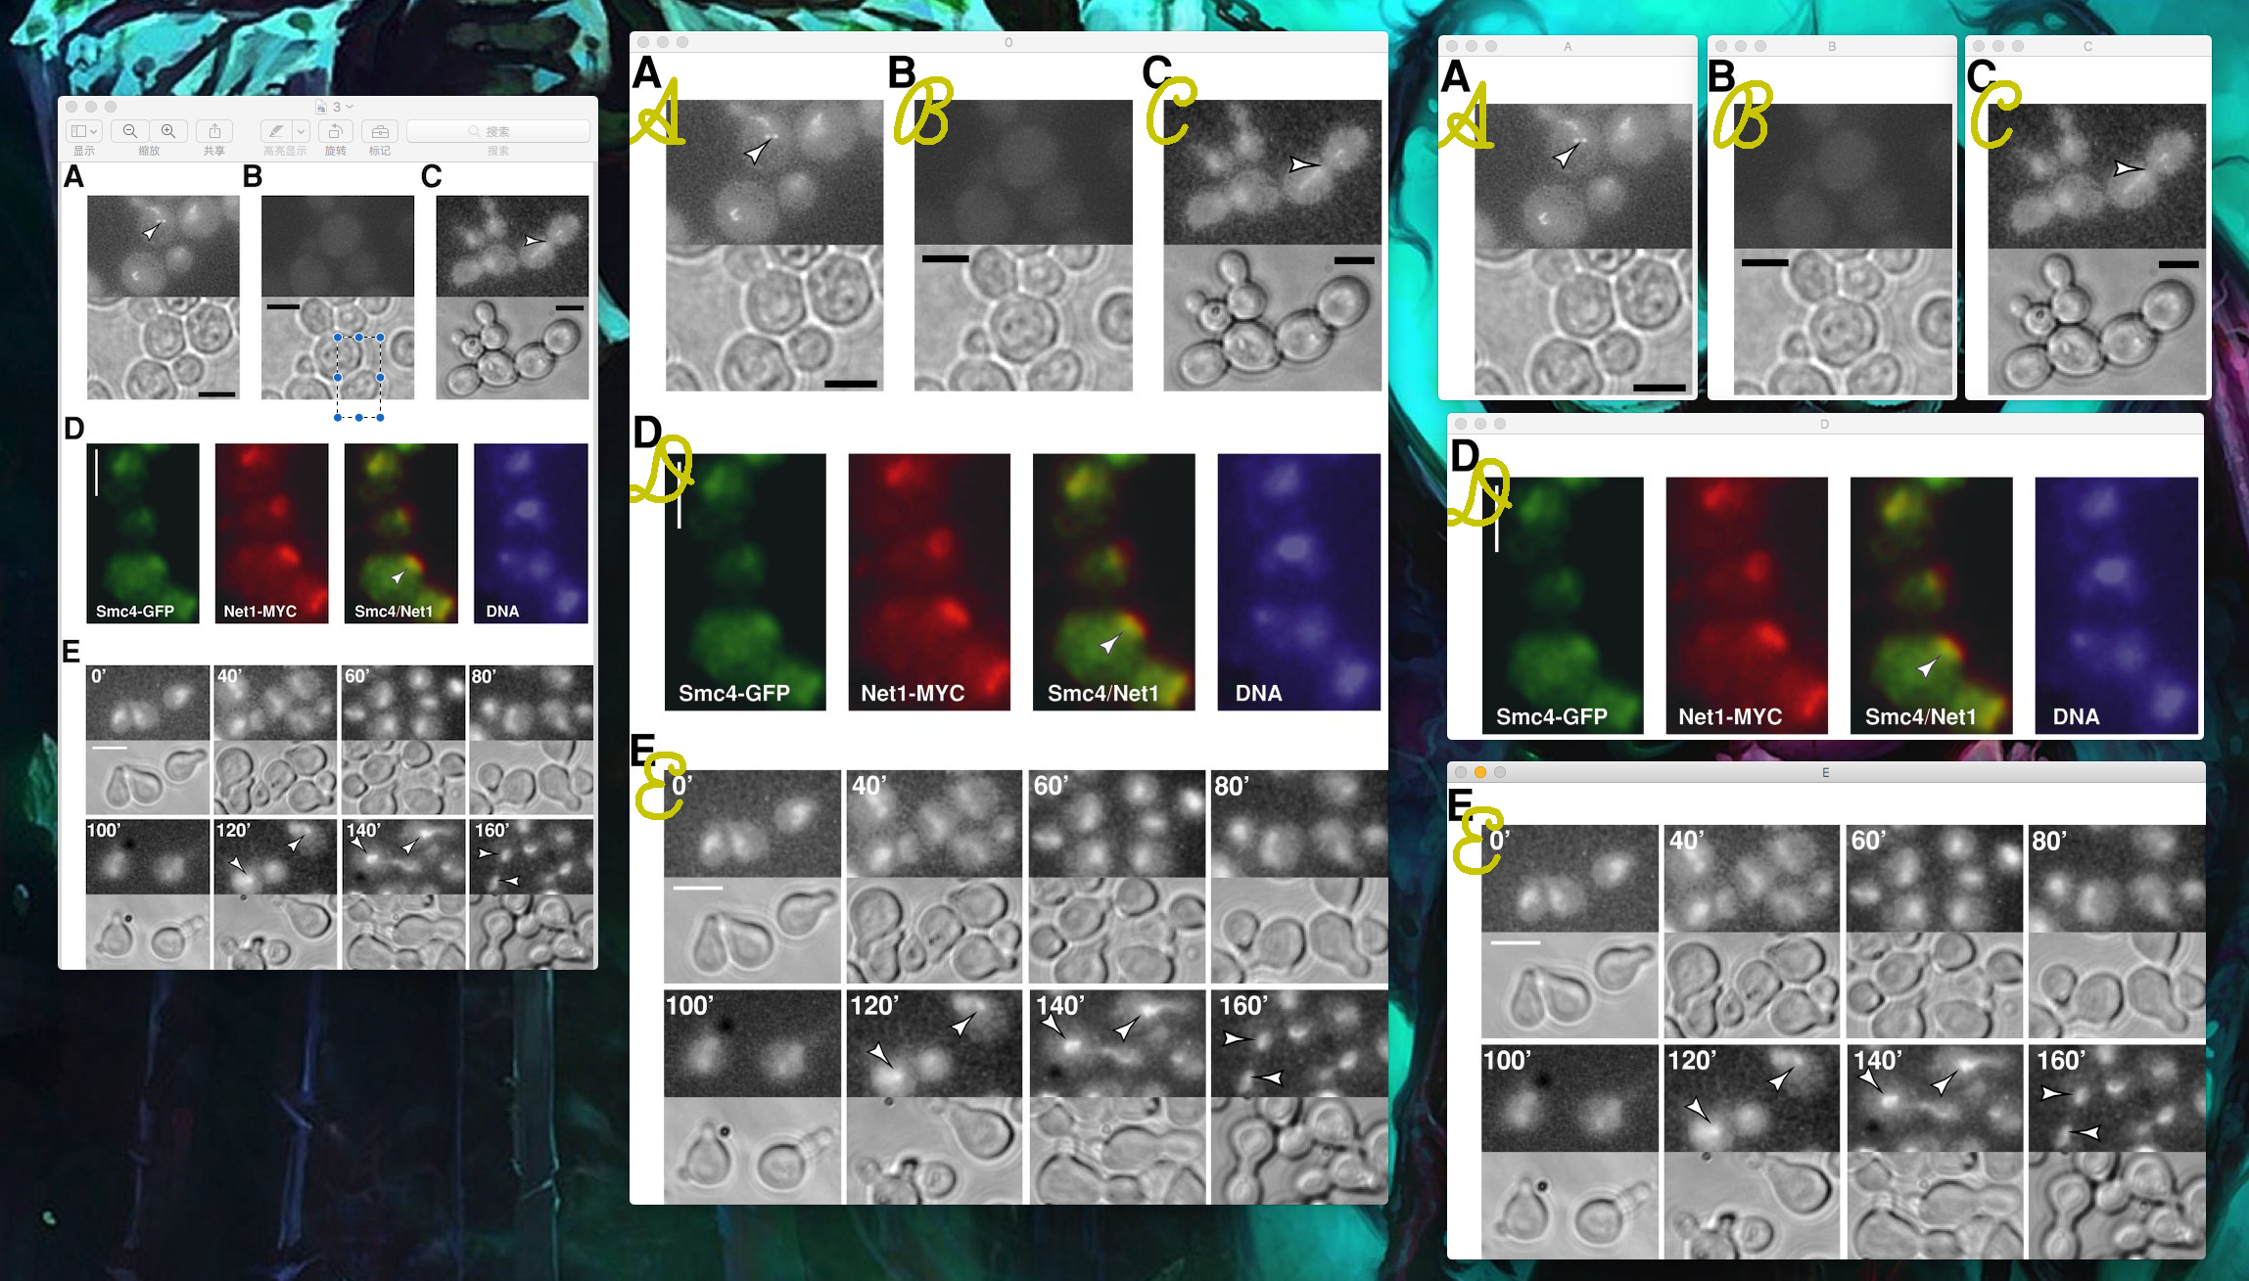

Slide 4


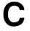

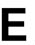
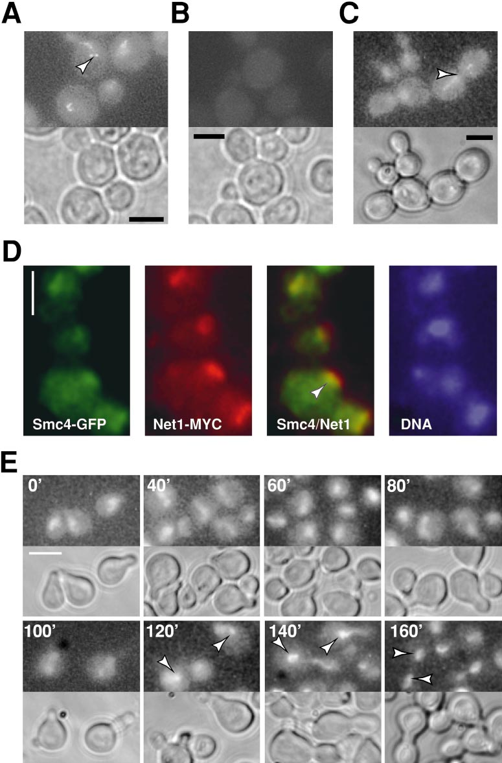
A
Moving windows in the image
Compare the window-image with our “A”s
Score the similarity
Python-lib (not accurate and slow)
Find the location of window of greatest score.
Naïve pattern recognition

Slide 5
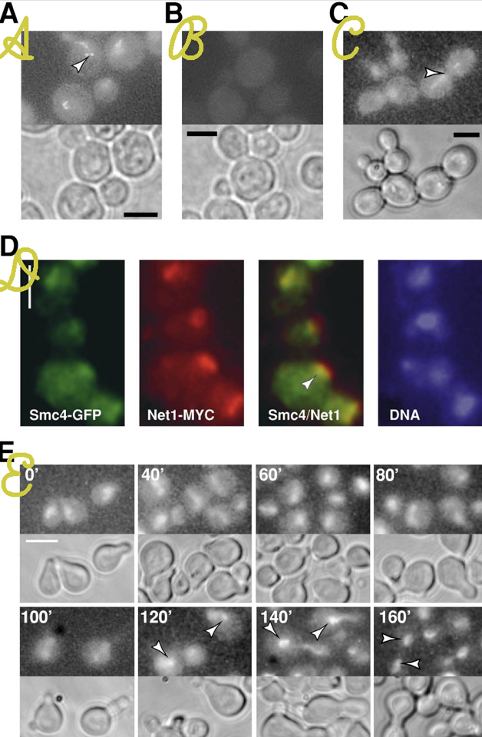
A {0,0}
B {460,0}
C {940,0}
D {0,650}
E {0,980}
Reverse the order: EDCBA

Slide 6
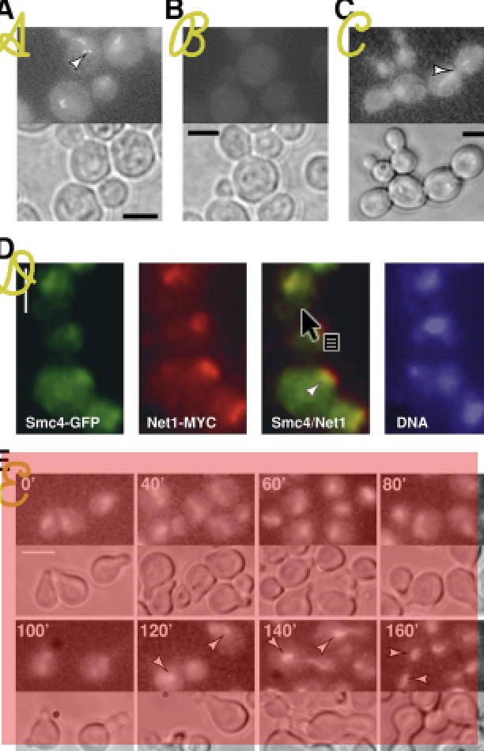
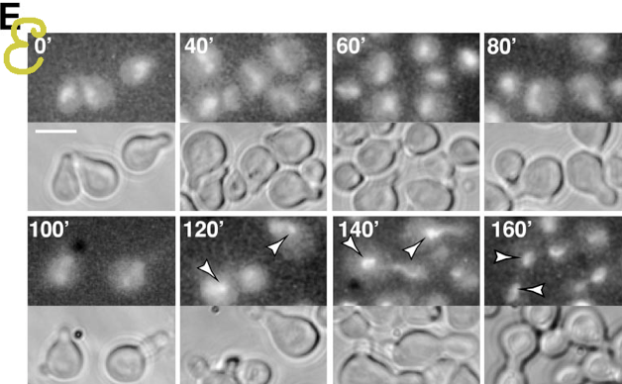

Slide 7
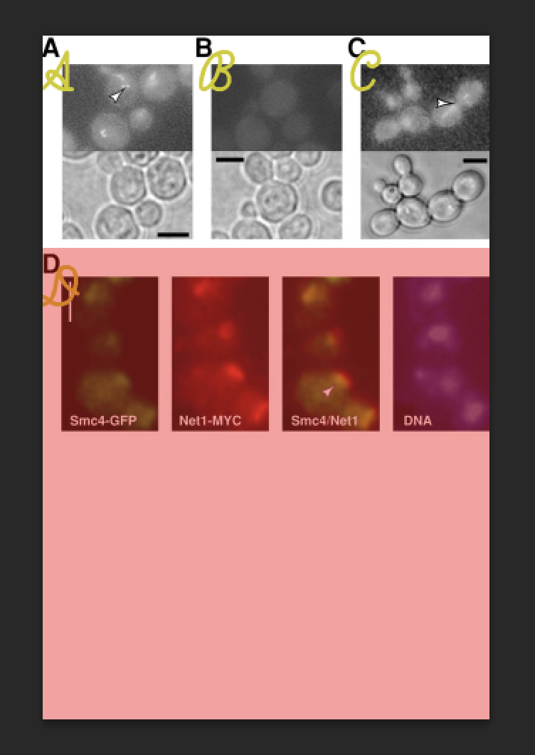
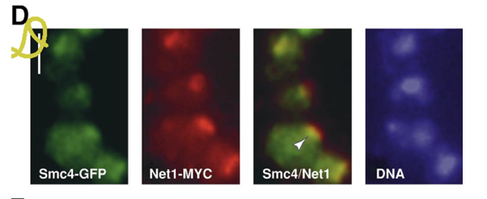

Slide 8
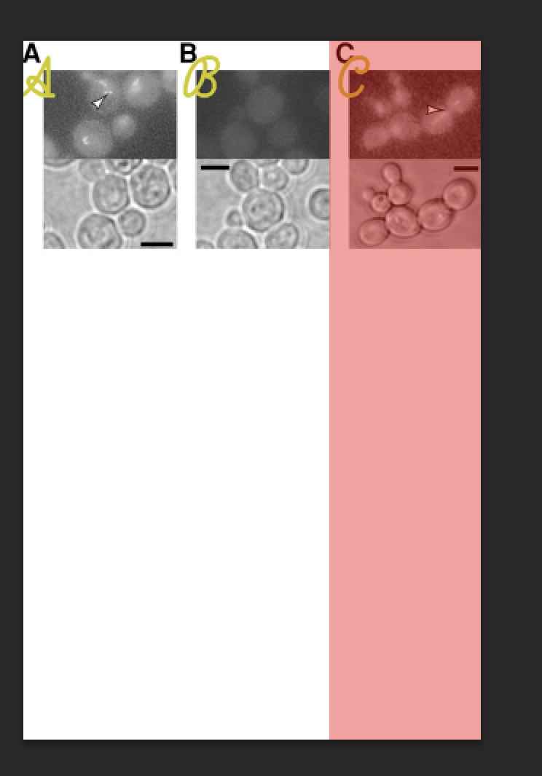
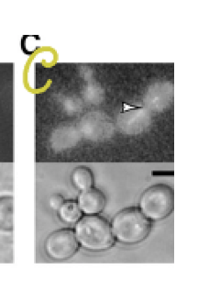

Slide 9
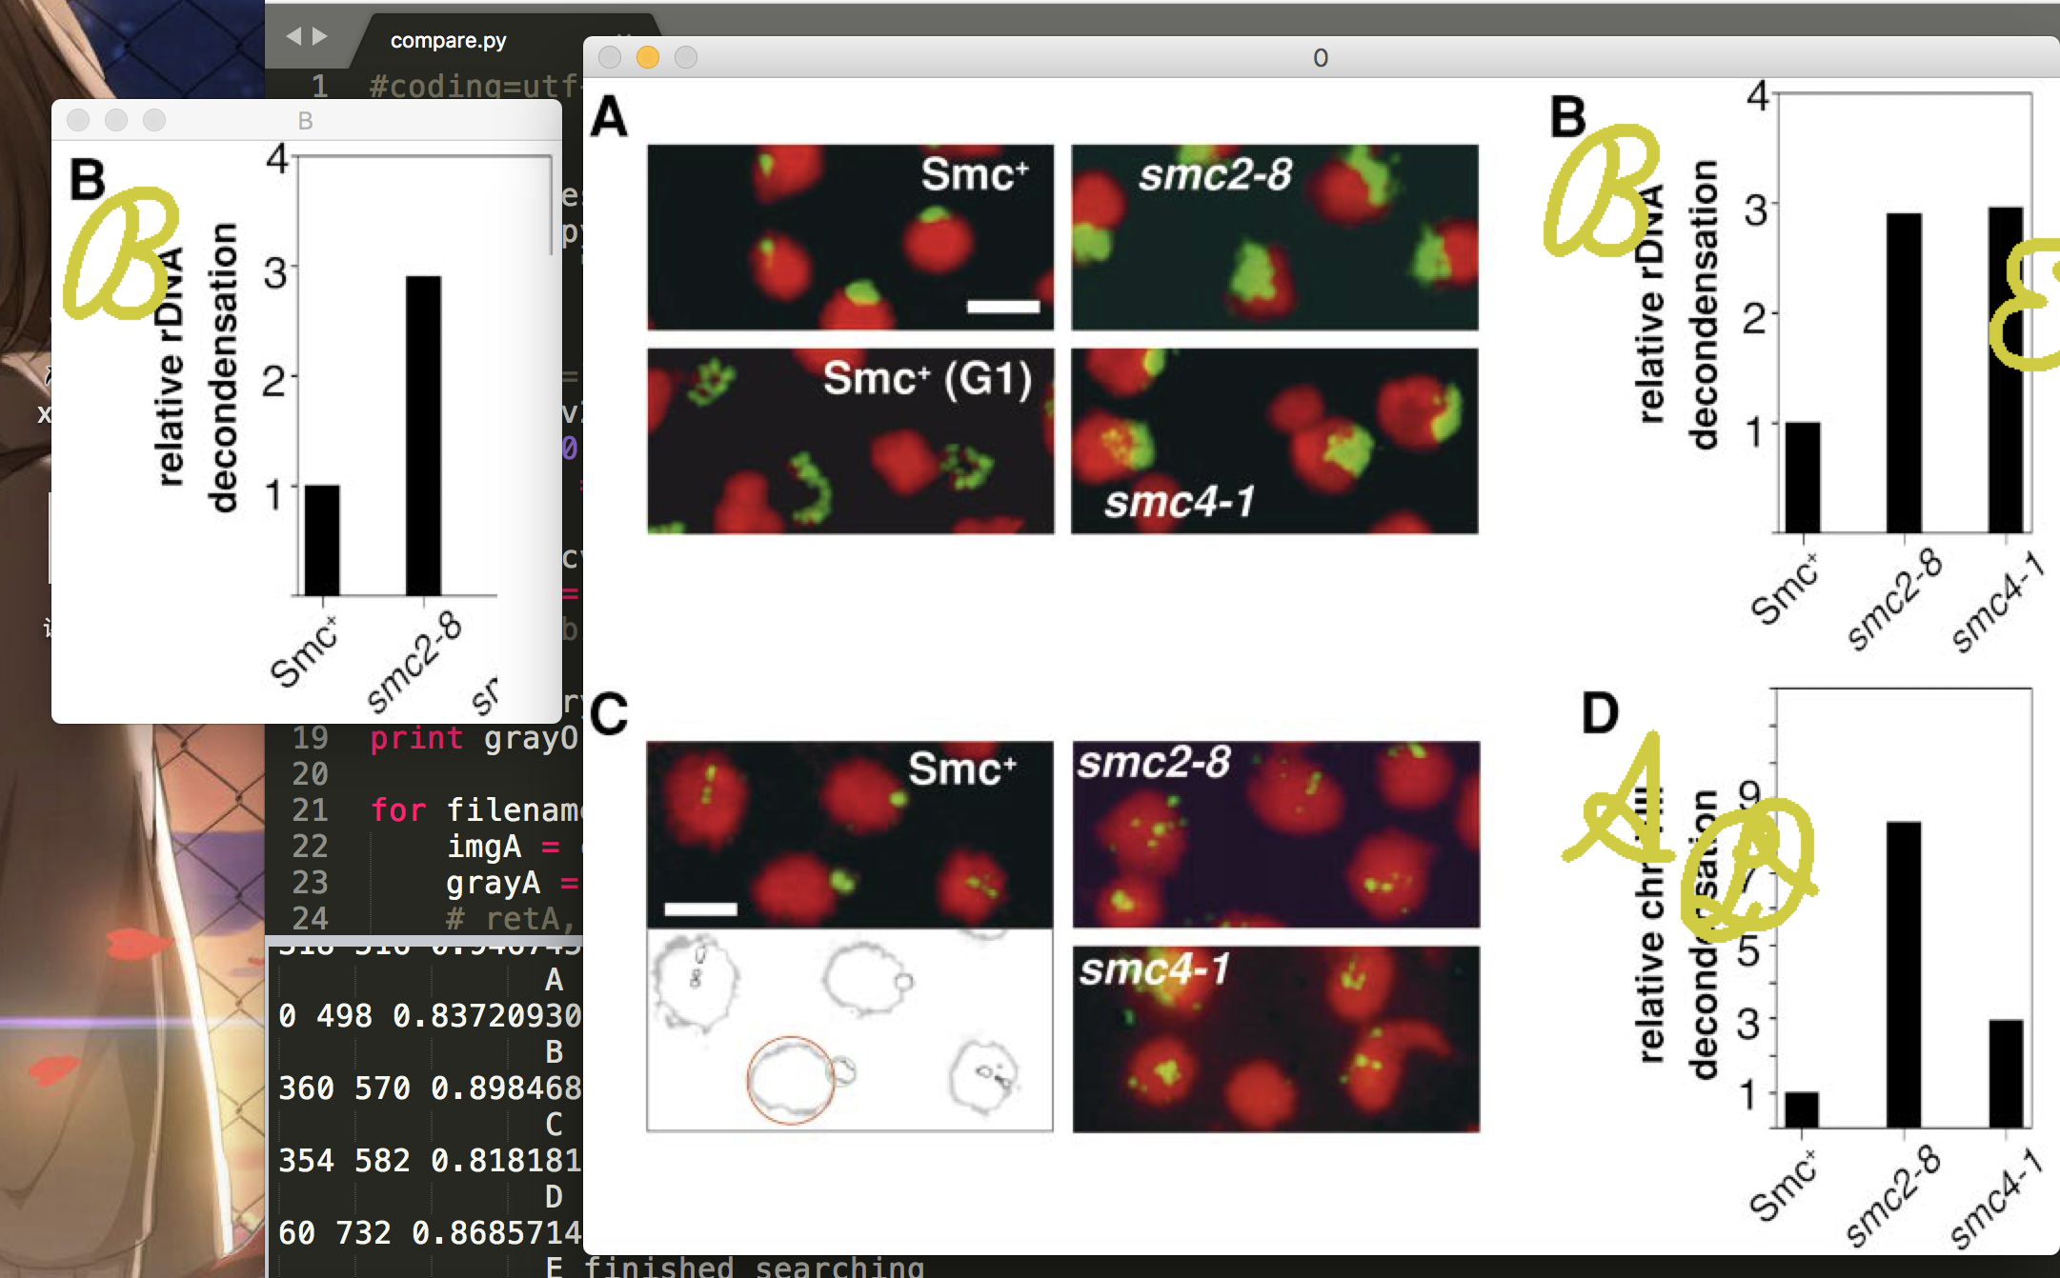
I think my idea is feasible.
So is the algorithm.
What matters is I have no idea to build a efficient OCR using python now.
Can be chaos

